Slide 1
Chapter 3
Genes and Evolution

Slide 2
The genetic basis of behaviour
Each cell contains our genetic code in the form of chromosomes
Genes are segments of DNA located on chromosomes
DNA is the active compound of each chromosome

Slide 3
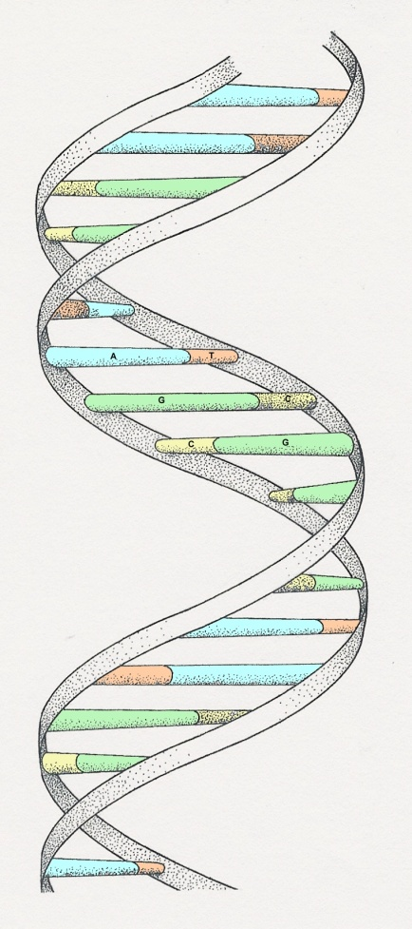
DNA – deoxyribose nucleic acid
3
The sub-units are called nucleotides
Each nucleotide is made up of
a sugar called deoxyribose
a phosphate group -PO₄
an organic base

Slide 4
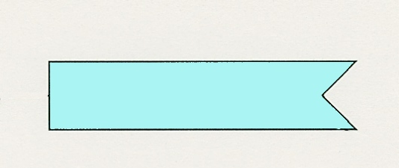
DNA bases
5
Adenine
(A)
Thymine
(T)
Cytosine
(C)
Guanine
(G)

Slide 5
RNA bases
5
Adenine
(A)
Uracil
(U)
Cytosine
(C)
Guanine
(G)

Slide 6
DNA replication
Enzyme topoisomerase unzips DNA
Primer needed
DNA polymerase then synthesizes a new strand of DNA
On the leading strand DNA polymerase moves along the DNA strand in the sugar (3') to phosphate (5') direction
On the lagging strand of short DNA fragments, called Okazaki fragments and DNA ligase, stitch these fragments together

Slide 7
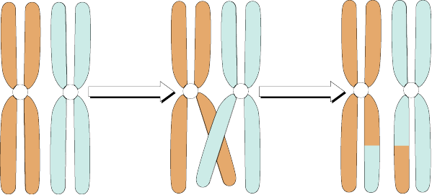
Chromosomes
There are 46 chromosomes (23 pairs)
Gametes – sperm & egg, each of which contains only 23 chromosomes
Fertilization – the two combine & cell has 46
Gametes formed by meiosis
During this process crossing over can occur
This process is responsible for individual differences

Slide 8
Cell division – mitosis
Interphase: The cell replicates its genetic material and organelles in preparation for division
Prophase: The genetic material in the nucleus condenses and the duplicated chromosomes become visible. The nucleolus disappears and the nuclear envelope begins to break down. Spindle fibres also start extending from both poles of the cell
Metaphase: The duplicated chromosomes become aligned in the centre of the cell, spindle fibres attach themselves to the centromere of the chromosomes
Anaphase: The stage of mitosis in which the duplicated sets of chromosomes separate and two identical groups move to opposite poles of the cell
Telophase: A nuclear membrane re-forms around each new group of chromosomes
Cytokinesis: Divides the nuclei, cytoplasm, organelles and cell membrane into two cells

Slide 9
Cell division – mitosis

Slide 10
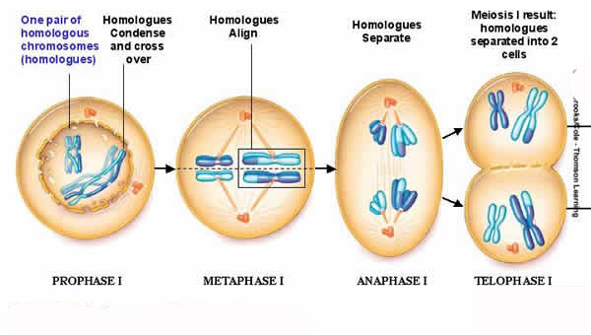
Cell division – meiosis I
Prophase I
Chromosomes condense and attach to the nuclear envelope. Synapsis occurs. Crossing over may occur. The centrioles migrate and the nuclear envelope breaks down
Metaphase I
Pairing of homologous chromosomes takes place along the centre line of the cell. The centromeres are located in the opposite poles
Anaphase I
The chromosomes migrate to the opposite poles of the cell. The sister chromatids still remain together
Telophase I
The chromosomes continue to migrate towards the poles. Cytokinesis take place. The nuclear envelope starts forming two daughter cells with haploid chromosome numbers

Slide 11
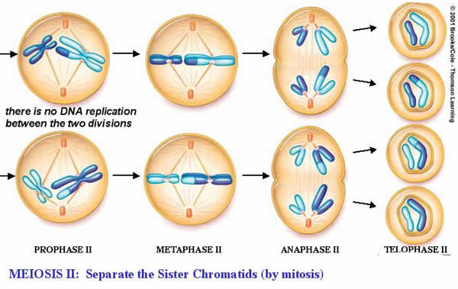
Cell division – meiosis II
Prophase II
The nuclei and nuclear membrane are separated and the chromosomes start moving towards the equatorial plane. The two sister chromatids are still held by the centromere
Metaphase II
The chromosomes are aligned in the equator and the centromeres are oriented towards the opposite poles
Anaphase II
The sister chromatids held at the centromere are separated by the spindle fibres
Telophase II
Four nuclei are formed, along with the process of cytokinesis, resulting in four daughter cells (or gametes) being formed

Slide 12
Individual characteristics
Dominant gene – expression will dominate
Recessive gene – expression only if both pairs are recessive

Slide 13
Protein synthesis
There are two stages necessary in protein synthesis: transcription and translation
Transcription begins at sites on DNA known as promoters
Uses an enzyme RNA polymerase
The most common promoters in eukaryotes is a short DNA sequence called a TATA box

Slide 14
Initiation
RNA synthesis begins with the initiation step
Initiation is the binding of the transcription mechanism to the DNA template
When 10 nucleotides long – escapes
Elongation starts
Not all starts are successful

Slide 15
Elongation
Nucleotides are added to the developing RNA chain
As the RNA polymerase travels along the DNA template strand, it comes in contact with a number of genes that contain blocks of DNA called introns
Introns interrupt the coding
Splicing removes these introns from the newly synthesized RNA

Slide 16
Sex cells
Also known as gametes
23 pairs of chromosomes
Crossing over: exchange of genetic material – combining genes
XY sex-determination method
XX – Girls
XY – Boys

Slide 17
Turner's syndrome
Atypical sex chromosomes
Only have a single sex chromosome: males and females are either X or Y
Unnatural sexual development in females
Low hairline, a strangely shaped chest and nipples that are far apart
Sometime cognitive disruption
Secondary sex traits are underdeveloped
Ovarian dysgenesis
Sterile

Slide 18
Klinefelter’s syndrome
Atypical sex chromosomes
Exhibit one extra female sex chromosome
XXY pattern, hence they have 47 chromosomes instead of the usual 46
One in 500 males – results in small testes, lack of sperm development and delayed puberty
Remain sterile

Slide 19
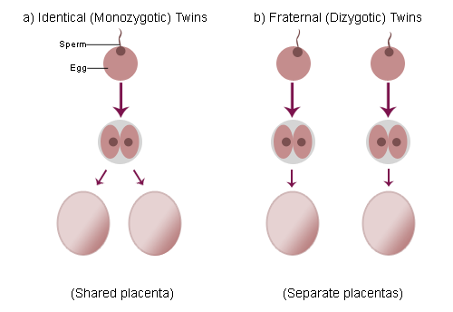
Influence of the environment on gene expression
Nature versus nurture
Heredity and surroundings are both important
Studies employ
Dizygotic (fraternal) twins
Monozygotic (identical) twins
Caution in interpreting studies
Because even identical twins can develop very different relationships with their parents and have disparate interests

Slide 20
Evolution of the nervous system
Single-celled organisms have no nervous system
Evolution for simple organisms
Phylogenic tree – show ancestry
Changes observed in a generation are minor
Cumulative effect as these slight changes occur during each generation and, in time, we can observe enormous changes in the organisms

Slide 21
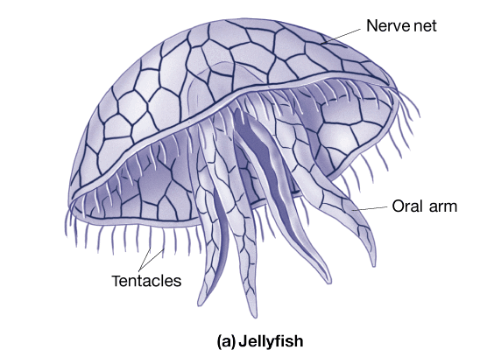
Diffuse nervous systems
Most of Earth's animals belong to the class of invertebrates
Jellyfish – specialized nerve cells but no nervous system
A mesh-like system

Slide 22
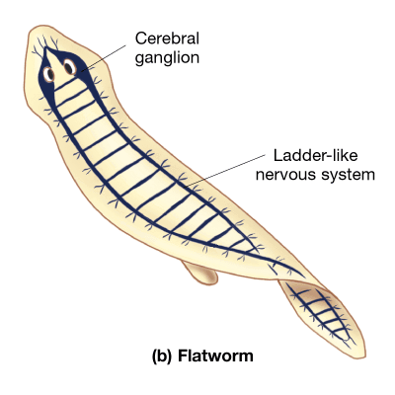
Centralized nervous systems – cephalized systems
Flatworm
Longitudinal nerve cords and peripheral nerve plexuses
Unsegmented nervous systems
Flatworms and roundworms have unsegmented nervous systems, meaning they behave as one unit

Slide 23
Centralized nervous systems – cephalized systems
Roundworm – have a simple ring of nerves
Non-segmented – so move as one unit

Slide 24
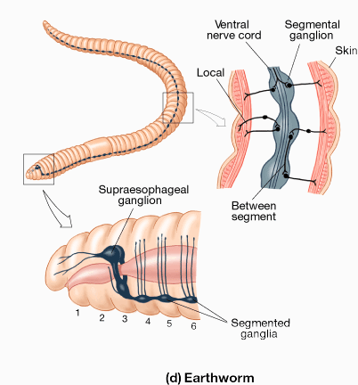
Centralized nervous systems – cephalized systems
Earthworm – brain with segmented nervous system
Nervous systems is segmented and each segment is able to act entirely on its own

Slide 25
Centralized nervous systems – compartmentalized systems
Aplysia californica – sea slug
Nervous functions that are mainly concentrated in the head region
Ganglia are fused
Observed basic learning & memory skills
Habituation
Sensitization

Slide 26
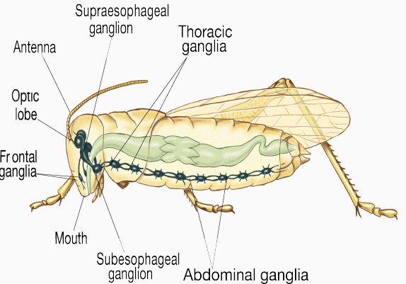
Centralized nervous systems – compartmentalized systems
More complex nervous system
Arthropods
Arthropod brains are made up of three principal sections
Insects may have as many as ten abdominal ganglia and three pairs of thoracic ganglia

Slide 27
The vertebrate system
Humans consists of 12 pairs of cranial nerves, 31 pairs of spinal nerve
Vertebrate brains are formed by the growth of nerve cells that gather together at the cephalic (head) end of the nerve cord
The oldest area of the human brain is the brainstem

Slide 28
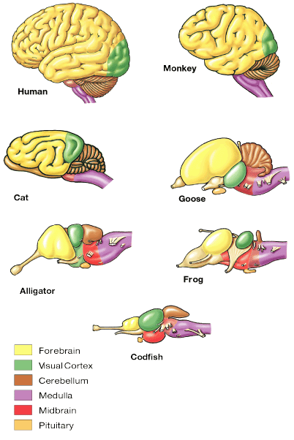
The vertebrate system – encephalization
As the brain develops, the role of the cerebral cortex in behaviour is increased
Dominance of cerebral hemispheres
The cerebral hemispheres start out as outgrowths from the forebrain. Major brain divisions
Structure of brain
Hindbrain
Midbrain
Forebrain

Slide 29
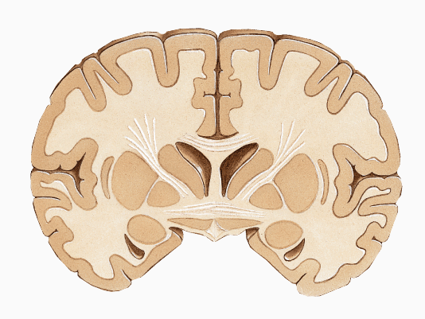
Dominance of the cerebrum
Forebrain greatly developed
Cortex is folded for increased surface area
Human cortex equivalent to approximately 2,500 cm²

Slide 30
How genes work

Slide 31
Nervous system

Slide 32
Readings
Barnes, J. (2011). Essential Biological Psychology (Chapter 3). London: Sage.
The Essentials
Ridley, M. (2003). Genes, Experience, and What Makes Us Human. New York: HarperCollins.
Next Steps
Darwin , C.R. (1859). On the Origin of Species by Means of Natural Selection, or the Preservation of Favoured Races in the Struggle for Life. London. London: John Murray.
Delving Deeper
Hawkins, R.D., Cohen, T.E., Greene, W., & Kandel, E.R. (1998). Relationships between dishabituation, sensitisation, and inhibition of the gill- and siphon-withdrawal reflex in Aplysia californica: effects of response measure, test time, and training stimulus. Behavioural Neuroscience, 112(1), 24-38.

